Slide 1
Agoda Training
Initiation to TypeScript
Cédric ROCHEFOLLE
July 2017

Slide 2

function Horse(name) {
this.name = name;
this.neigh = function() { console.log(“??”); }
this.clone = function() {
return new Horse(this.name);
}
}
var jim = new Horse(“Jim”);
function Dog(name) {
this.name = name;
this.bark = function() { console.log(“Baooww”); }
this.clone = function() {
return new Dog(this.name);
}
}
var joe = new Dog(“Joe”);
// 100 lines later
var dogClone = jim.clone();
What is TypeScript
Definition
Superset of Javascript
Inferred type
Optional type
Benefits
Compilation time error:
Typo
Type assignment
Intellisense

Slide 3
Variable Types
Annotation
Inference
“Indirect annotation”
Array
Tuple
Think Dictionary/Map
enum
Ambient ‘declare’
let and const

Slide 4
Object
Definition
Properties
Variables
Constructor
Literal
Index

Slide 5
Class
Definition
Members
public, private, protected, readonly, static
Extending classes
Abstract classes

Slide 6
Functions
(Fat) Arrow / Lambda function
“Captures” this
Caution:
Only if you need it
Callbacks: undefined danger
REST parameters
myFunction(param, …param2)
Spread operator
let rgb = [255, 128, 128];
mapRGB(…rgb) { }

Slide 7
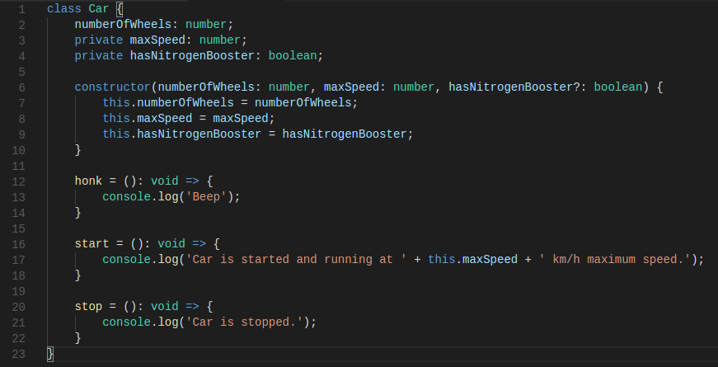
Find the error

Slide 8
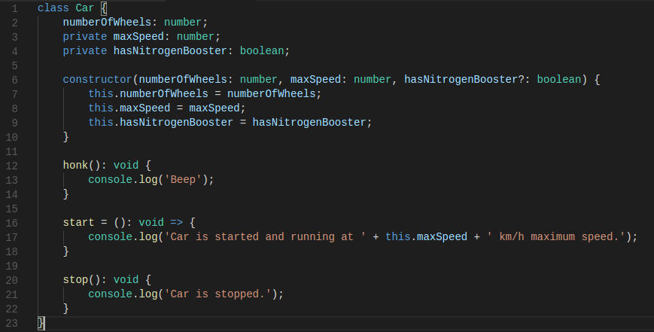

Slide 9
Interface
Definition
As a Data object
Useful for optimization
Extending interfaces

Slide 10
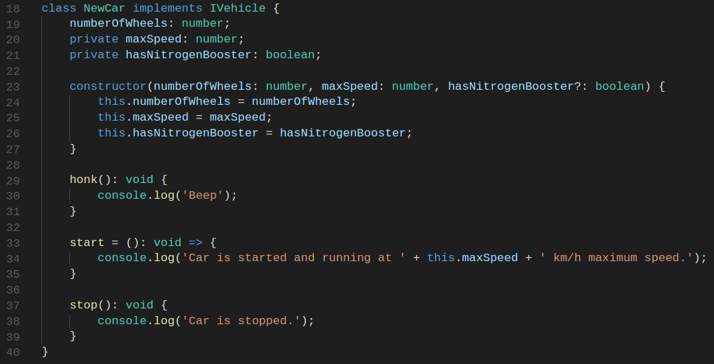
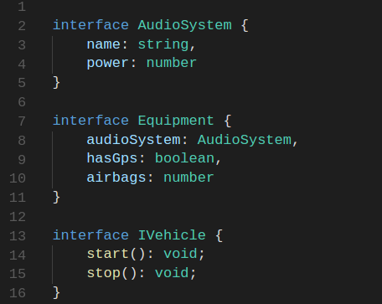

Slide 11
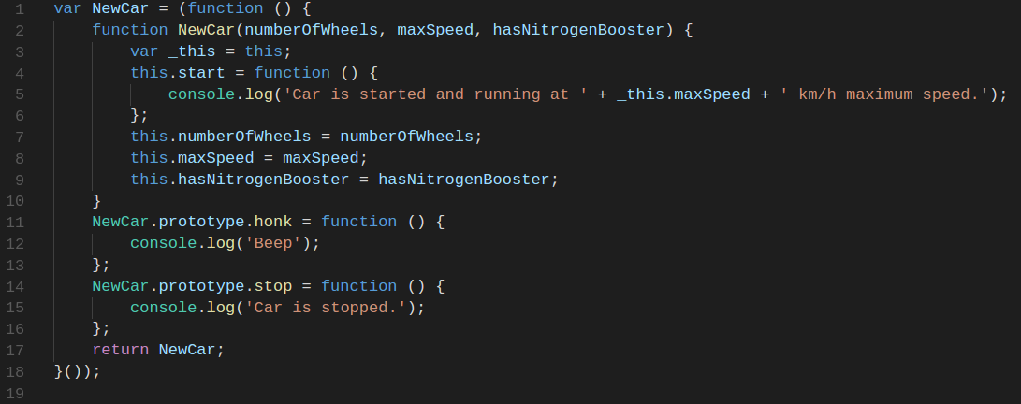

Slide 12
Additional Topics
Casting
Generics
class Validator<T> { … }
De-structuring
let rgb = {r:255, g:128, b:128};
let {r, g, b} = rgb;
g += 10;
Template Strings
let name = ‘John Smith’;
let someText = `Hello ${name}`;

Slide 13
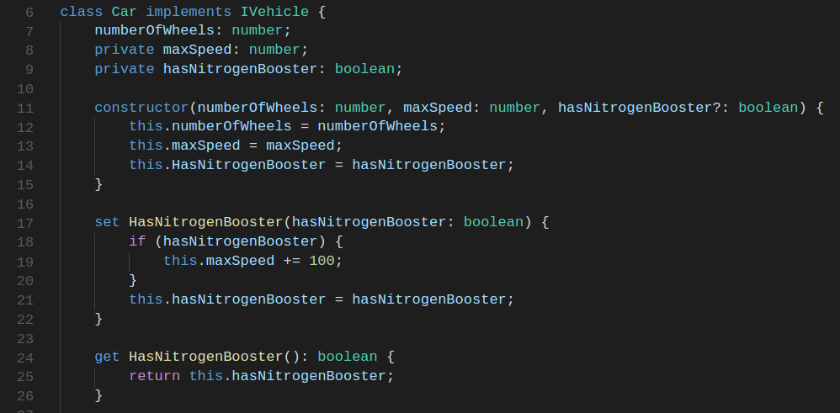
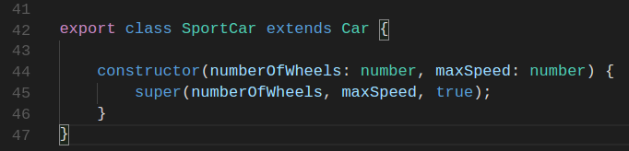
Additional Topics
for (let id of idList)
Property get/set
Extending class

Slide 14
Let’s get started
NodeJS 6+, 8+
https://nodejs.org/en/download or
https://nodejs.org/en/download/current/
Yarn (optional)
npm install --global yarn
Visual Studio Code
https://code.visualstudio.com/download

Slide 15
Get the startup project
Clone the project
https://github.com/CedricAgoda/agoda-typescript-initiation.git
Update dependencies
cd <root of project>
yarn install

Slide 16
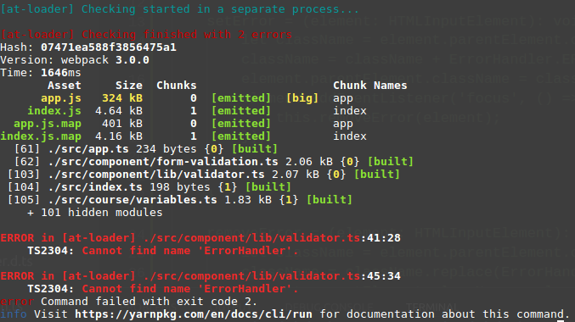
Get the startup project
Open Visual Studio Code
Browse to the root folder of the project
Build CTRL+SHIFT+B
it should build with errors, that’s OK!
Create a ‘car.ts’ and a IVehicle interface
Add method declarations:
Start()
Stop()

Slide 17
Project workshop 1
Create a Car class that implements Ivehicle
Add properties:
numberOfWheels
maxSpeed
hasNitrogenBooster
… anything else you like
Add methods:
Start()
Stop()

Slide 18
Project workshop 1
Create an instance of your car
.. and make it start and stop
Add HasNitrogenBooster getter/setter
Create a new SuperCar that extends Car
It should defaults to have a nitrogen booster
Add an instance of your super car
Make it start and stop
node public/js/index.js

Slide 19
Project workshop 2
Let’s fix the compilation errors
Then update the code to validate on blur of each input field

Slide 20
Module / Namespace
Definition
Namespace: “internal module”
Module: “external module”

